Slide 1
Climate Champions
How Congregations Can Catalyze
Climate Action in Florida

Slide 2
#1 Connect to Local Expertise
Notes:
Long term planning in the state of Florida is done by the regional planning councils, which serve in an advisory capacity to county and municipal governments. You can find resources related to your region’s climate change and sea level rise planning through the regional planning councils. You can contact the people listed as contributors to the plans for scientific and technical information about what is going on in your region.

Slide 3
QiQoChat Resources in Your Circle
Climate Vulnerability Assessments in your Region
Sea Level Rise Inundation Mapping and Local Predictions for your Region
Climate Action Plans for your Region
Sea Level Rise Action Plans for your Regions
Municipal Climate Action Plans
Municipal Adaptation Plans
Notes:
As time permits, I will post articles and files on QiQochat in these categories to help you find resources like speakers and sea level rise data for your location.

Slide 4
#2 Host a Climate Partnering Workshop
Notes:
Here is the invitation we used for out Climate Partnering Workshop. We secured a grant from the UUFBR Endowment Fund for the conference. They might be willing to fund yours. Their mission is to get our UU values into the world.

Slide 5
Workshop Objectives
Bring together members of the scientific-technical, faith-based, government and activist communities to:
Coordinate citizen support for regional and municipal climate action plans or to advocate for them
Get public support for climate policies
Develop effective Communications about climate policies
Notes:
These were the objectives of our Climate Partnering Workshop. In order to harvest information about what people bring to the table, have breakout sessions by action area (water issues, energy, transportation, etc.) with report back about priorities in each category and how attendees could help with action campaigns in each area.

Slide 6
Who Could Speak or Facilitate Breakout Groups
Experts who contributed to your regional Climate Action Plan or Sea Level Rise Assessment
Water Management District Experts
Municipal Planners who created Adaptation Plans
County Department of Environmental Services
Municipal Sustainability Officers
Adaptation Action Areas Experts
All speakers knowledgeable about local climate impacts & steps to address them
Notes:
Here is a list of the types of speakers who can connect residents to information about climate change impacts and planning that is relevant to their private property.

Slide 7
Ideas on Who to Invite
Engineers, Architects and Designers
Gardeners, Community Gardeners, Naturalists
Educators (K-12, Colleges and Universities)
Clerical and Lay Leadership/Green Teams from Local Churches
Green Businesses, Real Estate Agents, Property/Enviro Attorneys
Advocacy, Labor, Civic Groups and HOA leaders
Environmental and Conservation Foundations
Community Development Personnel
Notes:
Consider theses groups of people when you invite people to your partnering workshop.

Slide 8
UUFBR’s 2013 Workshop
Notes:
This is what our partnering workshop looked like.

Slide 9
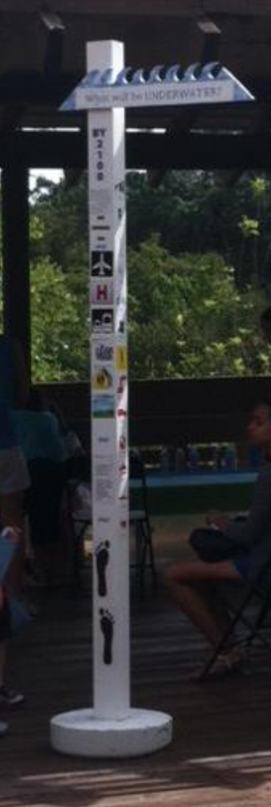
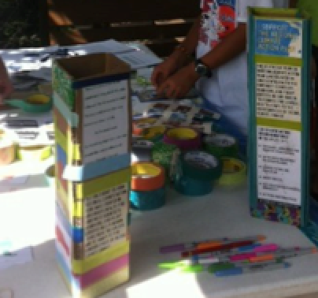
Include Climate Education for Children
Notes:
We had climate education for kids at our workshop. We partnered with the FAU Dept of Education. They were creating a Climate Change for Kids curriculum funded by NASA. They had experiments for kids that demonstrated principles of atmospheric science. We had them make small craft versions of a Sea Level Awareness Project pole. The SLAP poles have four sides: one side shows lifestyle changes that have negative or positive effects on global warming. One side has information about our regional climate action plan (RCAP). The third and fourth sides have stickers that show how much infrastructure (air ports, schools, taxable real estate, etc.) will be compromised at 1 ft or 2 ft of SLR

Slide 10
Train Girl Scouts to Staff Tables at Community Events
Notes:
We trained Girl Scouts to speak about the effects of climate change and about our RCAP. They earned badges by completing the training and by staffing tables at a pre-arranged Interfaith Earth Day event.

Slide 11
Kick off an Action Campaign at the Workshop
Notes:
We kicked off an action campaign at the workshop in support of the RCAP and maintained a database of all the people who supported it with their addresses so we could determine their districts when we gave the cards to their representatives.

Slide 12
With Invitations, Request Volunteers to Help
Climate educators for kids
People to document with pictures you can post
People to help get signatures for the petition drive or campaign you have initiated as part of the workshop.
Logistics or printing support
Notes:
When you send out your invitations, ask for volunteers. Let people waive the cost of the workshop if they volunteer. This gives people who could not otherwise come an opportunity to do so.

Slide 13
#3 Invite Attendees into Coalition
Have individual conversations with leaders who attended to invite them into coalition
Schedule a meeting time and invite these leaders to attend
See who shows up. If you have 5 or more, you can build great things
Notes:
After your event, follow up with the attendees one on one. You can send out a group email of thank for the great conference, certainly to all presenters and facilitators. But follow up personally with others to invite the to a pre-scheduled coalition-exploration event.

Slide 14
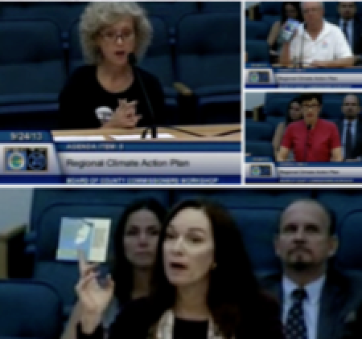
#4 Follow Through on Your Action Campaign Together
Notes:
Follow through on your Action Campaign with your allies. Deliver petitions, go to speak with your legislators. Finish what you started. In theses pictures we spoke before our county commissioners in support of our Regional Climate Action Plan before they voted on it. We pre-met with them. Here you see Representatives of our just-forming coalition: LWV of Palm Beach County, Arthur R. Marshall Foundation for the Everglades, Organizing for Action of Palm Beach County and the Treasure Coast, and the Unitarian Universalist Fellowship of Boca Raton.

Slide 15
#5 Create a Unifying Mission Statement
Mission
To organize, coordinate and execute grassroots activities across a spectrum of non-partisan groups that promote the recommendations from the Southeast Florida Regional Climate Action Plan (RCAP) and the Federal Administration’s Climate Action Plan to address climate change impacts in Southeast Florida and consist of:
Raising public awareness through public education and outreach
Engaging in advocacy campaigns
Spurring the public into action
Supporting events and advocacy campaigns of individual coalition member organizations, when appropriate.
Notes:
Talk through the coalition structure with participating organizations. Be aware that 501c3 organizations can not support individual candidates, but 501c4 organizations can. This is why our Climate Action Coalition of South Florida documents stress the non-partisan nature of the coalition.

Slide 16
#6 Create a Unifying Vision
Our multi-year goal is to make Climate Change and its consequences a top priority for the public and public officials in Palm Beach County and South Florida that results in the reduction of carbon emissions and the protection of the built and natural environments in the region through adoption of mitigation and adaptation strategies from the Southeast Florida Regional Climate Action Plan (RCAP) and the Federal Administration’s Climate Action Plan.
Notes:
Make sure everyone is heard when creating the Vision. You want the coalition to be a win for every organization: advancing the goals of member organizations so they stay involved.

Slide 17
#7 Define Objectives and Priorities
Acknowledgement from the majority of residents and businesses in South Florida that Floridian’s are exceedingly vulnerable to the consequences of Climate Change, and therefore, we must take charge of our future and demand that our public officials do the same.
Federal, state and local government collaboration with more funding for integrated plans that address the consequences of climate change, in recognition of South Florida’s high vulnerability to Sea Level Rise and Extreme Weather.
Local governments’ signature on the Southeast Florida Regional Climate Change Compact Mayor’s Pledge in support of the Southeast Florida Regional Climate Action Plan (RCAP), and to incorporate Climate Change into their local comprehensive plans, requiring implementation of adaptation and mitigation strategies from RCAP and the Federal Administration’s Climate Action Plan.
The State Legislature to consult annually with the Southeast Florida Regional Climate Change Compact to determine state policies that best respond to Sea Level Rise and Extreme weather.
Congress, the State Legislature and Agencies and Local Governments support of the Environmental Protection Agency’s (EPA) Clean Power Plan and to put plans in place to reduce carbon emissions from power plants by 38 percent from 2005 levels by 2030.
Notes:
Here are the objectives and priorities we chose. Every coalition will have their own, any many items will be unique to place.

Slide 18
Projects and Campaigns
UUFBR
Notes:
The following are projects and campaigns that UUFBR initiated.

Slide 19
SLAP POLES
Gumbo Limbo Nature Center
The Youth Activity Center
Veteran’s Park in West Boca Raton
Pine Jog Environmental
Education Center
Traveling SLAP pole
Notes:
Our Religious Education classes had a unit on climate change. It included games and lessons on the statements about climate from the faiths of the world and climate science instruction from John Englander (author of High Tide on Main Street: The Coming Coastal Crisis). John is a member of UUFBR. The SLAP poles, created by our kids were placed at the above locations. The fourth pole is in our Sanctuary Garden. Here is a link to instruction on how to make one: http://www.uufbr.org/wp-content/uploads/2015/10/teacherkit-howtomakeaslappole.pdf You can substitute data from the regional sea level rise assessment from you region.

Slide 20
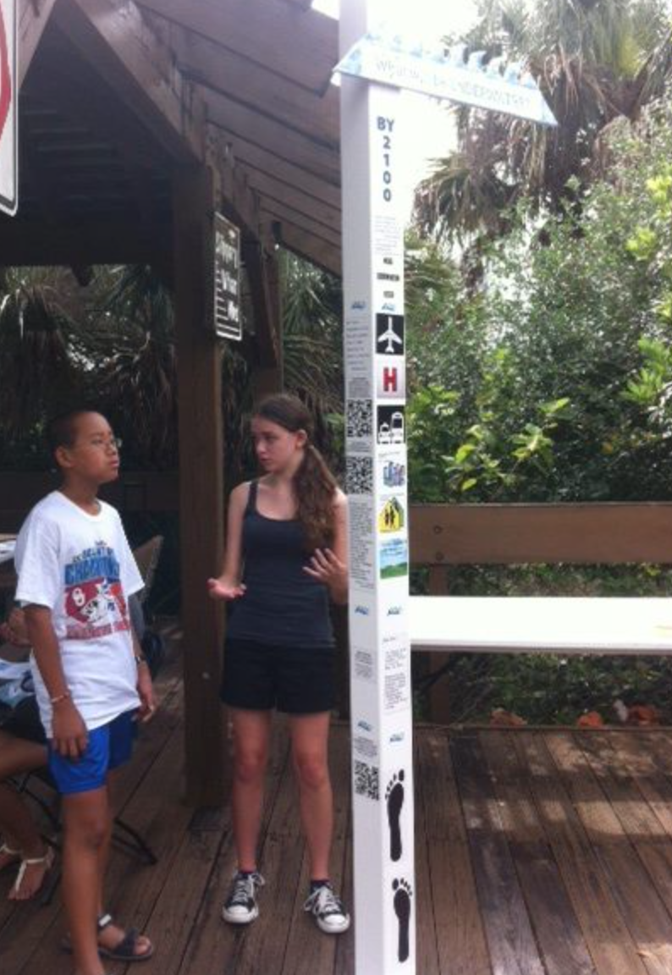
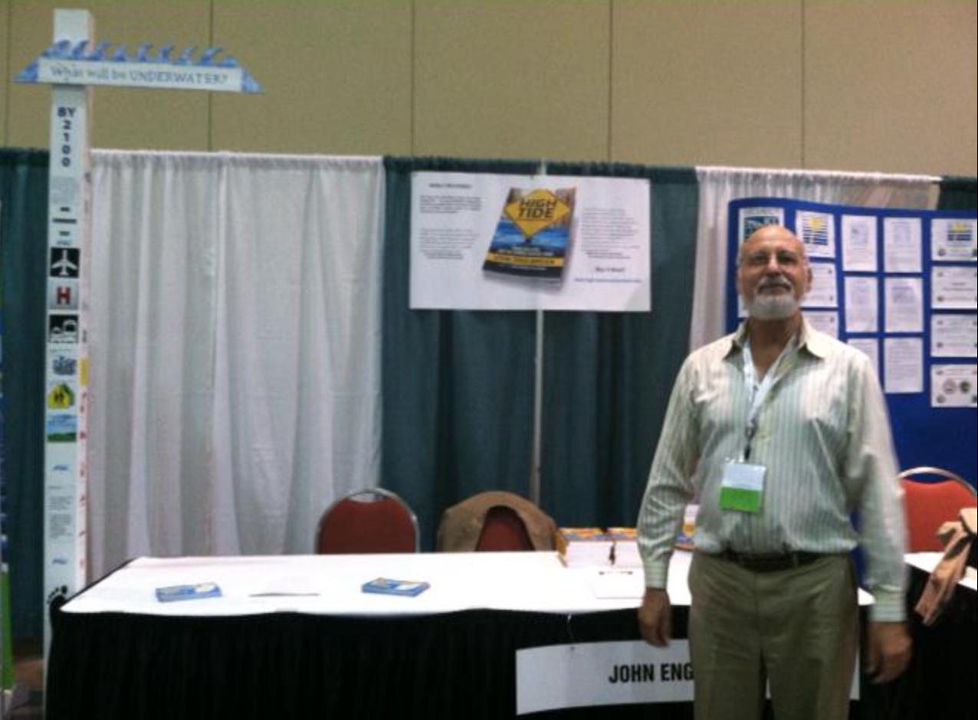
Notes:
We took our traveling SLAP pole to events. As our coalition was forming, we continued to take the postcards in support of the RCAP to events as well as the SLAP pole craft. John Englander was promoting his book, and he often allowed UUFBR’s SLAP pole to tag along at tabling events.

Slide 21
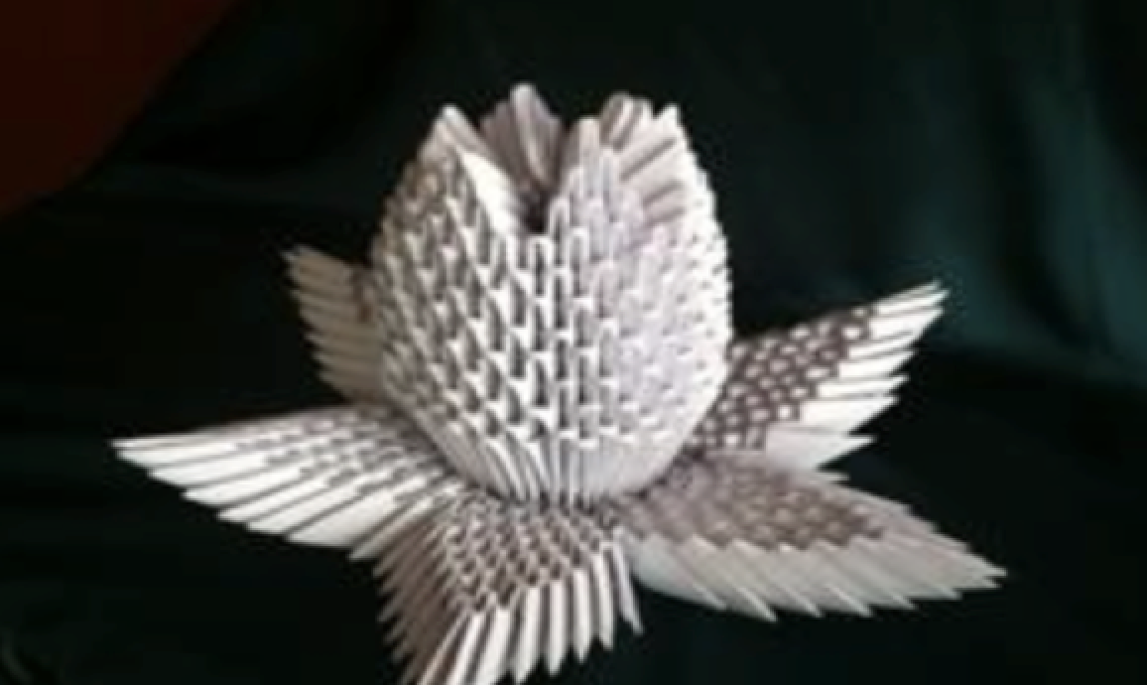
Origami Everglades
Notes:
In association with our Florida Earth Festival, we partnered with M+G Foundation on a public art project. We involved over 20 schools and community centers in the folding of triangles used to construct a life-sized panther and several lilies. We placed the panther in public libraries and at the zoo to raise awareness about the Everglades and about habitat destruction in the Everglade and how restoring the Everglades helps to mitigate against saltwater intrusion. Here is a link to information about M+G Foundation’s project http://www.uufbr.org/wp-content/uploads/2015/10/teacherkit-howtomakeaslappole.pdf

Slide 22
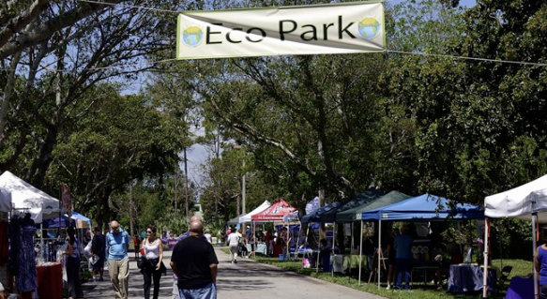
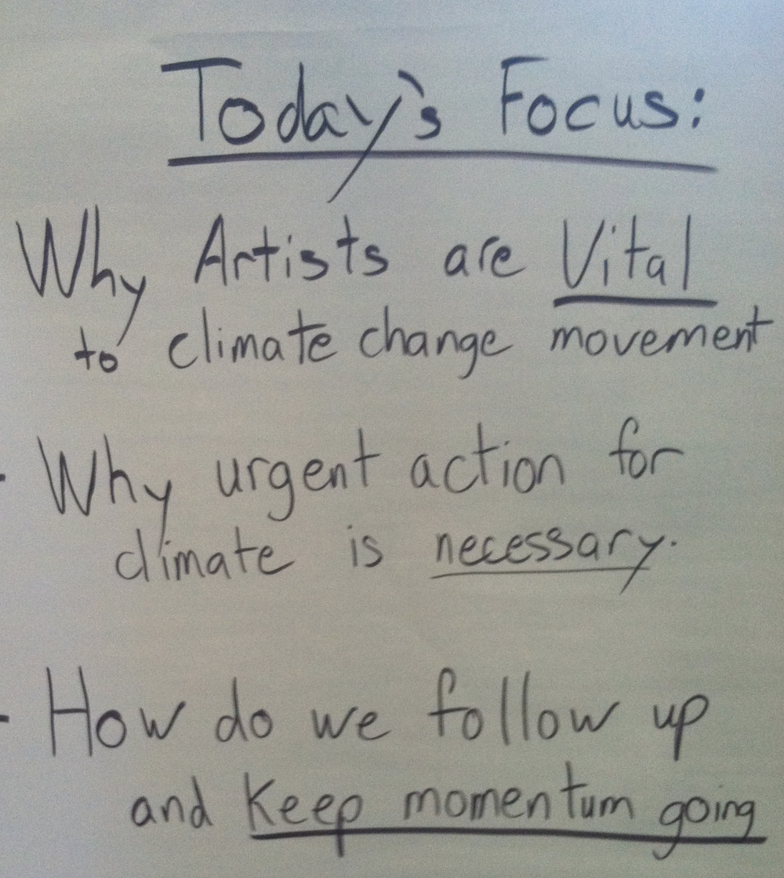
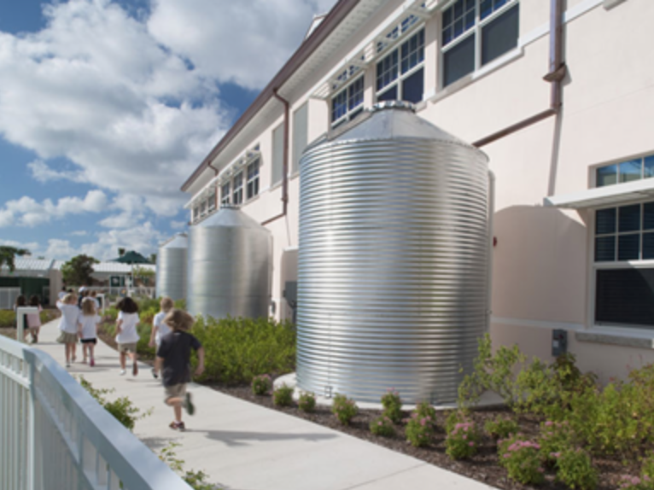
Florida Earth Festival
Notes:
We have an Earth Day Festival that helps us to connect with green businesses and non-profits. We partner with the Gold LEED certified school across the street from our Fellowship for parking and to give tours of their school. In 2015 we held the first workshop in the state of Florida for artists who wanted to learn how to engage in climate activism. http://www.floridaearthfestival.com

Slide 23
Environmental Justice Public Health
Unitarian Universalist Fellowship of Boca Raton
EPA Environmental Justice Small Project Grant
Notes:
Our Green Sanctuary Committee secured an EPA grant to partner with 2 vulnerable communities: one in Boca Raton and one in Delray Beach. In my congregation, at UUFBR, our Green Sanctuary Team and our Healing Justice Group are partnering with two minority communities to train residents to be effective climate communicators in English, in Creole or in Spanish. We are preparing a Tri-lingual Adaptation Toolkit that will be online; a Powerpoint that explains it; and a brochure with magnet (so it can go on the refrigerator) with phone numbers and links that are important to residents where there is frequent standing water, the risk of a boil water order, or floodwater. A few residents in each of the two communities will be trained to explain the public health risks in their communities from climate change and sea level rise to their neighbors in a neighborhood canvass.
The climate communicators trained in this project will be empowered to educate their neighbors, and to report at a community meeting so they are held up as community public health experts on health risks related to climate change impacts. Ties within the minority communities: between the English speaking African American residents and the Creole-speaking and Hispanic-speaking immigrants, who are their new neighbors, will be strengthened so they can increase their ability to work together in the event of a hurricane or another hazard. This will increase their climate resilience.

Slide 24
Projects and Campaigns
Climate Action Coalition of South Florida
Notes:
The following are projects that we undertook with our growing coalition.

Slide 25
Education and Outreach
Speakers Bureau Administrated by the League of Women Voters of Palm Beach County
Tabling Events
Notes:
It took 3 years to agree on and to create the presentation used for our speakers’ bureau. The LWV has a list of Homeowner’s Associations and Civic groups to which it offers programming on a variety of subjects. This presentation includes basic climate science, information about our regional climate action plan, and civic action campaigns relevant at the time the presentation is given, so petitions are signed and collected.

Slide 26
Community Discussions
Notes:
As part of the HighWaterLine Delray Beach project undertaken by the coalition, community conversations were held in neighborhoods currently experiencing climate impacts. Here is a link to the HighWaterLine archive http://www.floridaearthfestival.com/highwaterline/

Slide 27
Workshops
Notes:
HIghWaterLine workshops were held at Earth Festival 2015. Here is Dr. Keren Bolter, a sea level rise expert from our region presenting information about sea level rise. Residents of neighborhoods already experiencing the effects of sea level rise were present. Participants from minorities were given coupons for lunch and assistance with transportation so they could attend.

Slide 28
Municipalities Campaign
Objective:
To get all municipalities in Palm Beach County to Sign the Southeast Florida Regional Climate Change Compact’s Mayor’s Climate Action Pledge
Boynton Beach (original municipal signatory in PBC)
Delray Beach
West Palm Beach
Jupiter
Notes:
The municipalities control all land use decisions. Most of our coastal area is controlled by municipalities, not county governments. In order to get cooperation on adaptation, contiguous municipalities must accept the same SLR data for building requirements, and must cooperate with neighboring municipalities.

Slide 29
Grassroots Toolkit on Website
Notes:
The Grassroots Toolkit available online has many tools needed for grassroots advocacy. Many aspects of the Toolkit are relevant statewide, although this Toolkit was developed for Palm Beach County. https://cacflorida.wordpress.com/grassroots-toolkit-south-florida/

Slide 30
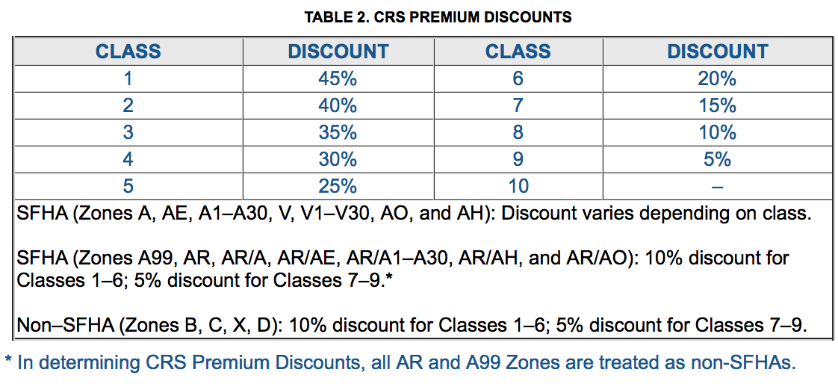
FEMA Community Rating System (CRS)
Notes:
Points are given for steps taken by municipalities to manage the floodplain to reduce the community’s risk. Some municipalities are not participating in this program, in which case participation is an advocacy goal. Municipalities with 10 are participating, but have the most need for improvement.
Flood insurance rates are discounted for homeowner’s flood insurance, as well as for insurance on municipal infrastructure in the percentages indicated in this chart.

Slide 31
Example CRS Ratings
Yankeetown
Inglis
Port Charlotte
Winter Park
Venice
Boca Raton
Ft. Myers
Gainesville
Tampa
Rating 6, 20% Discount
Rating 10, no discount
Rating 6, 20% Discount
Rating 10, no discount
Rating 6, 20% Discount
Rating 8, 10% Discount
Rating 7, 15% Discount
Rating 7, 15% Discount
Rating 6, 20% Discount
Notes:
Here are some of the municipalities that Climate Champions from member UU congregations at the Florida iCAN 2016 General Assembly, with their FEMA CRS ratings.

Slide 32
FEMA CRS Categories
Public Information
Mapping and Regulations
Flood Damage Reduction
Warning and Response
Notes:
Here is what you are advocating for the municipality to do when you advocate for FEMA CRS rating improvement. There are 19 actions the municipalities can take. They are divided into the categories shown here.

Slide 33
Local Mitigation Strategy
Reduce vulnerability
Justifying funding for hazard mitigation projects and initiatives
Notes:
The Local Mitigation Strategy is a list of shovel ready projects. These projects are prioritized, and are funded in the order of priority. Many of these projects are funded with funds received immediately after a major disaster with federal or state money. It is important that shovel ready projects reflect rebuilding to higher standards for increased SLR. Otherwise, money is wated on projects that can not withstand the next hazard.

Slide 34
Adaptation Statutes in Florida
Notes:
This is a slide used by Jim Murley in his outreach on Adaptation Action Areas. Note the South Florida Regional Planning Council logo. This is the definition of an Adaptation Action Area.

Slide 35
Notes:
This is the Florida Statute that allows the AAA designation to be included in the Comprehensive Plan of each and every municipality and county in FL.
If you are living in an area that fits the description here, you may have an advocacy goal of formal recognition as an AAA in order to receive priority funding.

Slide 36
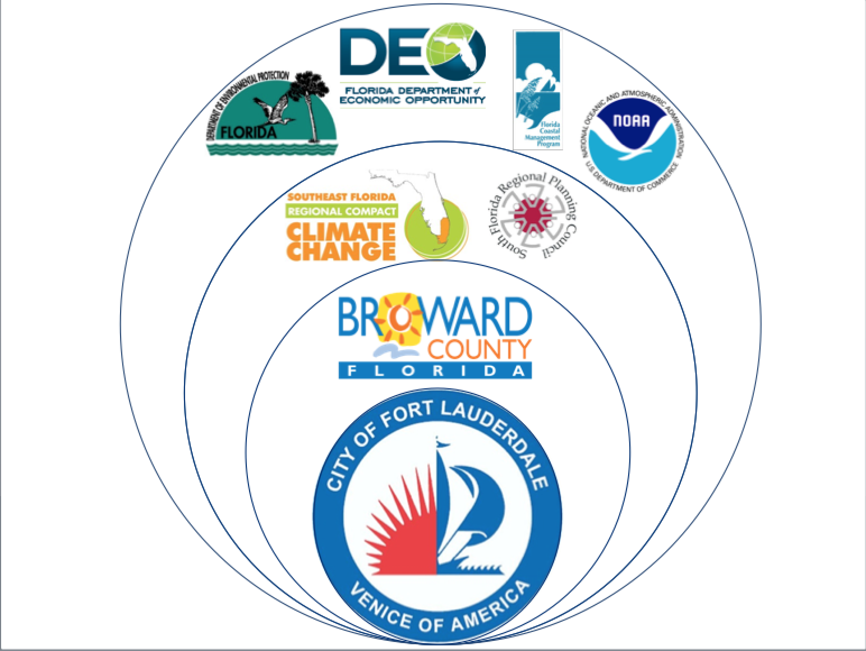
Notes:
The City of Ft. Lauderdale did the pilot study for AAAs with the full support and cooperation of Broward County . This was supported by the Southeast Florida Regional Climate Change Compact and the South Florida Regional Planning Council. More broadly in the State of Florida The Florida Department of Environmental Protection, The Florida Department of Economic Opportunity and the Florida Coastal Management Program cooperated on the effort. NOAA has consistently provided technical support and cooperation for Florida’s climate resilience building efforts.

Slide 37
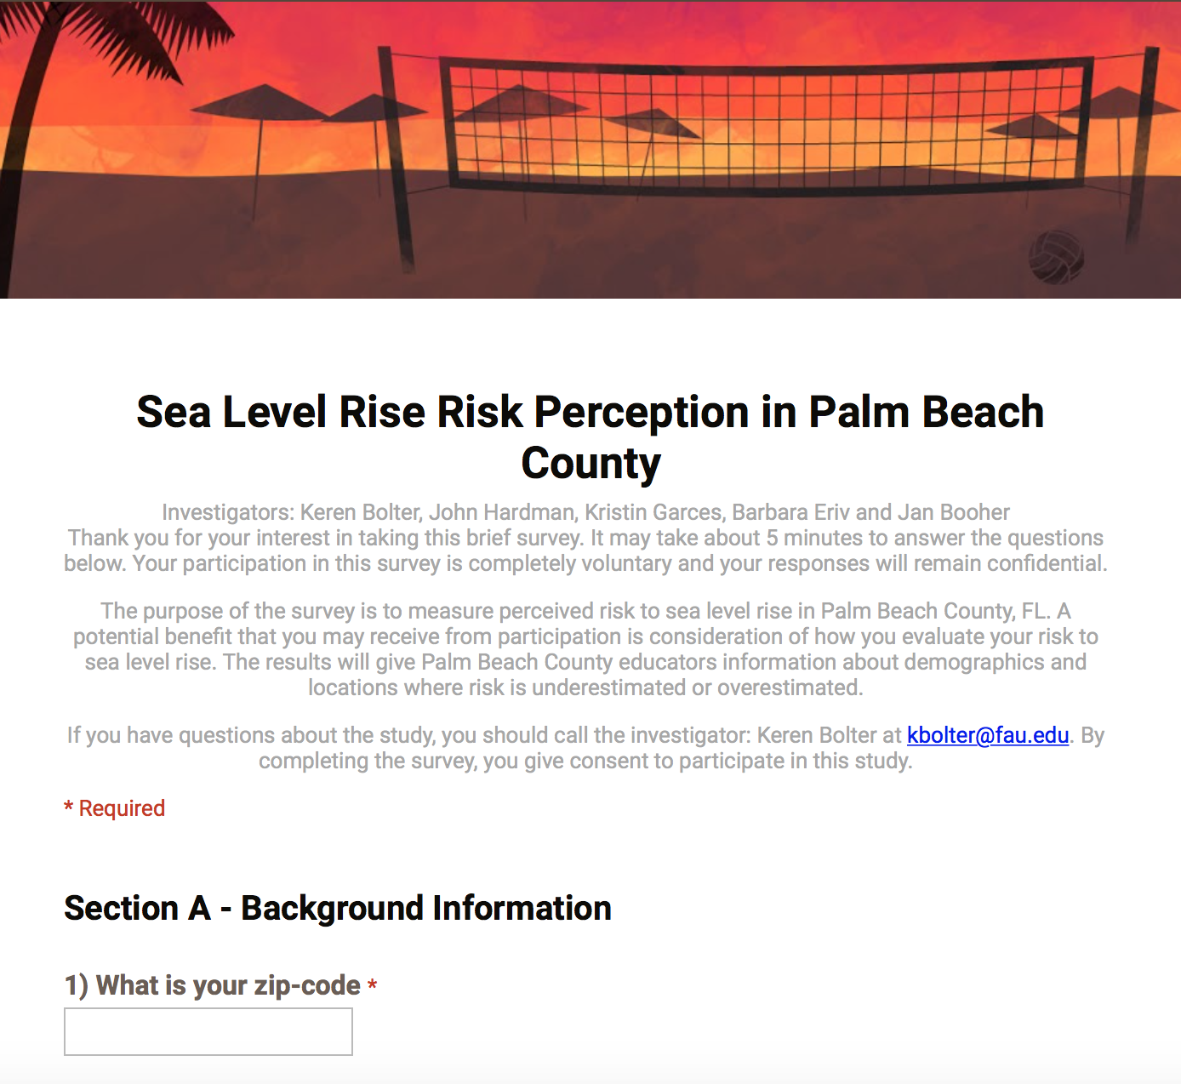
Sea Level Rise Risk Perception Survey
Notes:
We have an on-going SLR Risk perception survey to document the public’s understanding of risks from SLR. The lead investigator is Dr. Keren Bolter at FAU-Center for Environmental Studies. After HighWaterLine Delray Beach, DR. Bolter arranged for two students at the Bren School in California to aggregate the data and to create template white papers and correspondence for municipal officials in Palm Beach County. Here is a link to the survey http://www.floridaearthfestival.com/take-the-sea-level-rise-risk-perception-survey-for-palm-beach-county/

Slide 38
Petitions and Resolutions Spreadsheet
RCAP Resolution
EPA Clean Power Plan Resolution
Climate Change Resolution
Notes:
We have had petition drives as noted here, and we archive the names and addresses so we can tell public officials about interested citizens in their districts. Introverts who do not want to do other things can do this on their own time and it is POWERFUL.

Slide 39
First Campaign 350 Postcards in 2013
Notes:
In our attempt to get signatures in support of the RCAP in 2013 our coalition was just forming. We were able to get 100 postcards in support of the RCAP to city commissioners in Miami-Dade County by cooperating with the CLEO Institute. We were able to deliver 250 postcards to PBC Commissioners prior to their vote, by district.

Slide 40
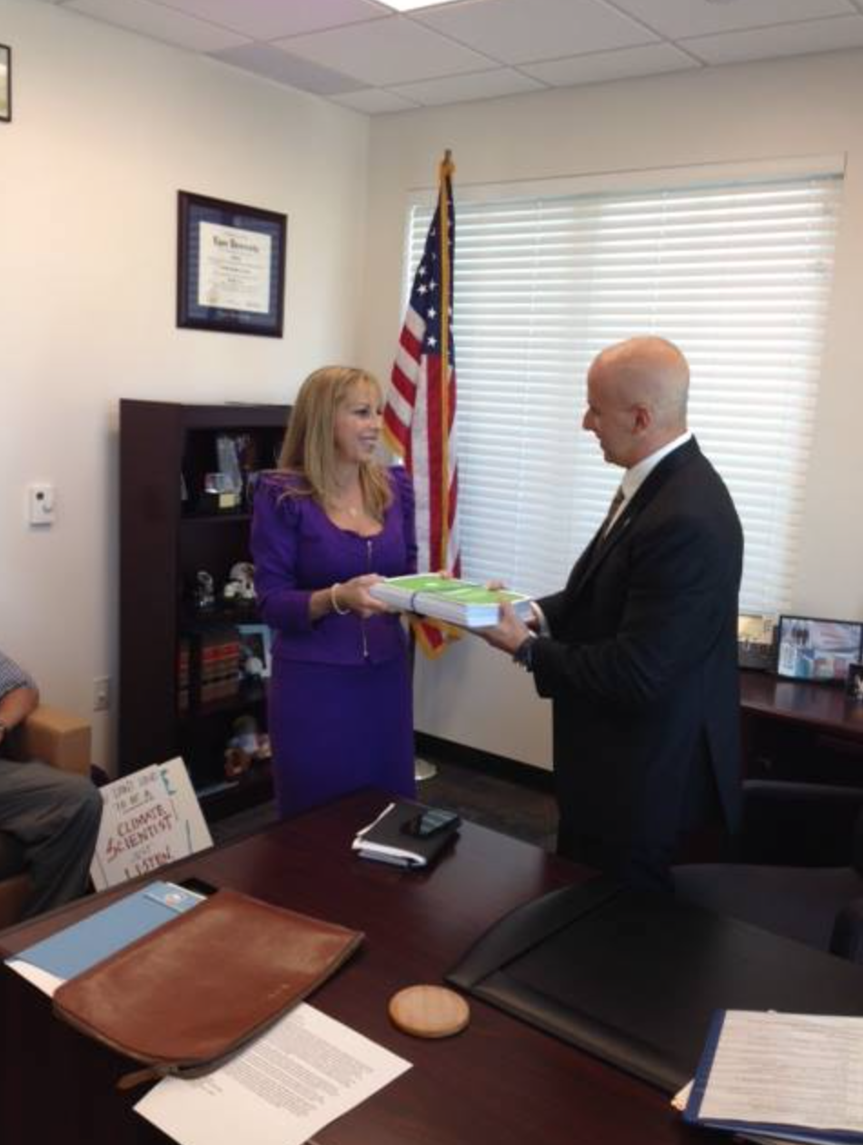
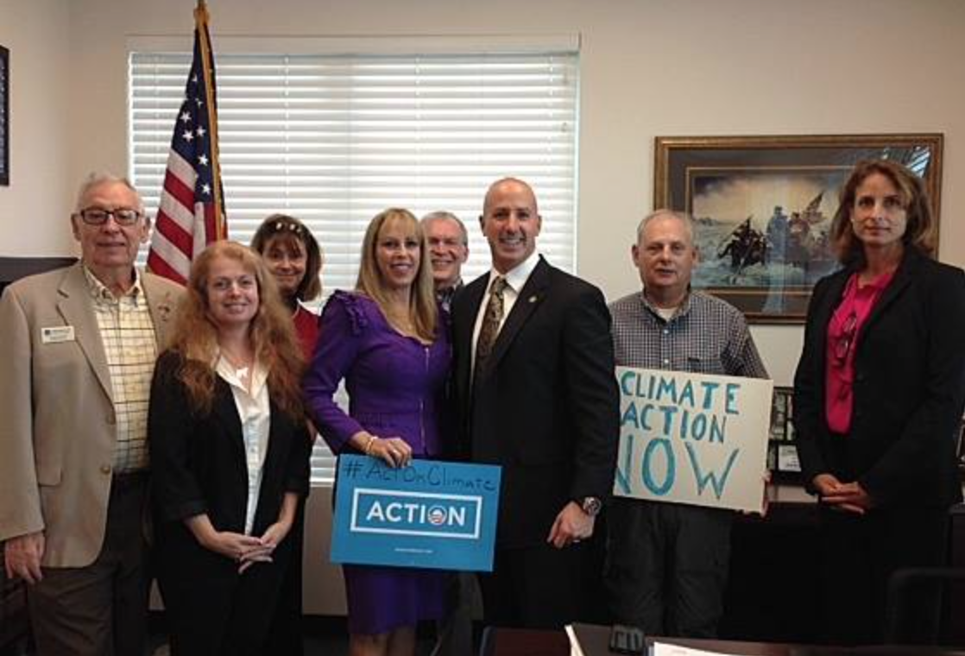
EPA Clean Power Plan 19,000 Petitions in 2014
Notes:
As our coalition grew, we were able to find more support. Here are members of our coalition delivering petitions. Organizing for Action and Sierra Club lead this campaign, with strong League of Women Voters petition gathering support.

Slide 41
All Coalition Organizations
Notes:
All member organizations in the Climate Action Coalition are supporting the Floridians for Solar Choice campaign.

Slide 42
Oral Histories
Notes:
We are collecting a database of oral histories about personal experiences with flooding.

Slide 43
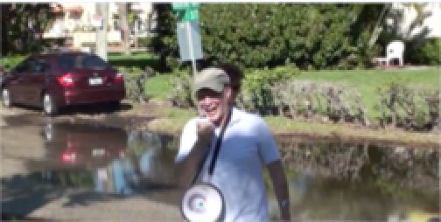
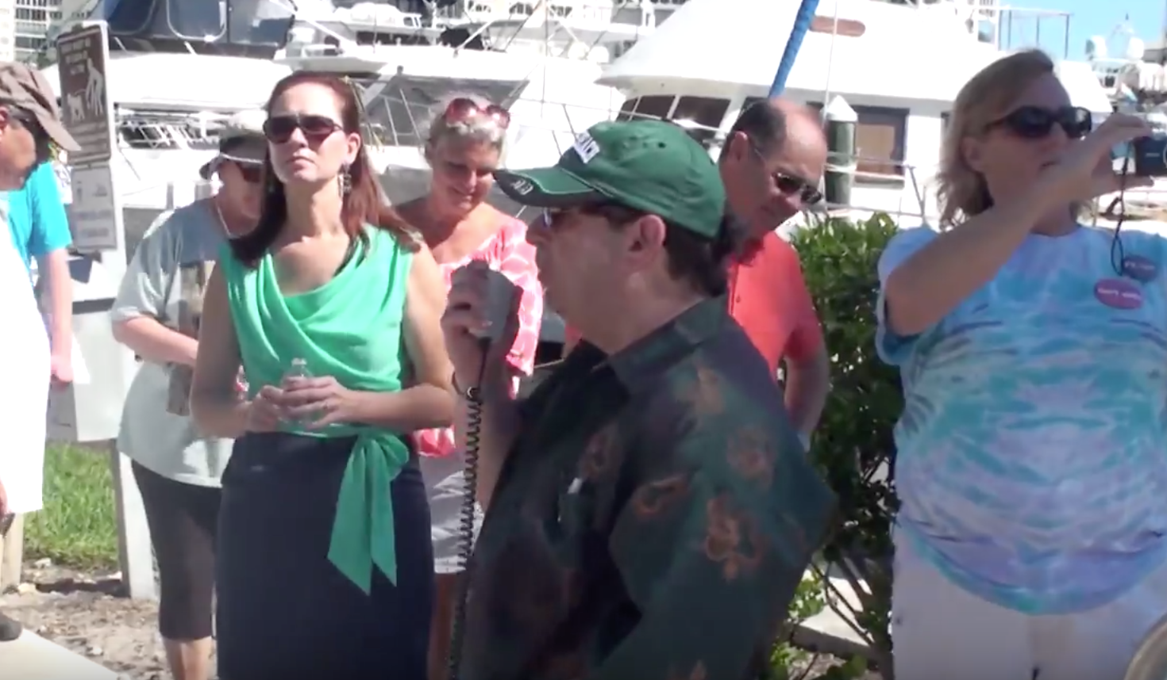
King Tide Action 2013
Notes:
We held an Action during the highest tides in 2013. We had a planning expert present information with inundation maps of the neighborhood. We watched saltwater bubbling up through the storm drains and had residents explain the problems they are coping with: replacing cars that have chassis damage from saltwater, raising air conditioners, driveways and houses, etc. Public officials attended, and the neighborhood is receiving back flow preventer valves. Here is a link to a video of the Action: https://www.youtube.com/watch?v=0HjN0kmraD0&feature=youtu.be

Slide 44
HighWaterLine Delray Beach
Notes:
Here is news coverage of the HighWaterLine Delray Beach project
http://www.wptv.com/news/region-s-palm-beach-county/delray-beach/group-visualizes-potential-effects-of-climate-change-in-delray-beach
http://wlrn.org/post/chalk-and-rising-seas-combine-delray-beach

Slide 45
HighWaterLine
Notes:
The HighWaterLine Delray Beach required massive coalition building within the community. Funding was received from the Florida Humanities Council, The Unitarian Universalist Fund for Social Responsibility, the City of Delray Beach Public Art Advisory Board, and the League of Women Voters.

Slide 46
Marina Historic District
Notes:
The chalk line at 4 ft of elevation was drawn in 3 locations already experiencing flooding.

Slide 47
Minority Neighborhoods
Notes:
One of the locations was a minority community. The UUFBR Green Sanctuary Team led the organizing effort in this community.

Slide 48
Message Mural
Notes:
This is a painted canvas mural that people sign to commit to stand up for the earth.

Slide 49
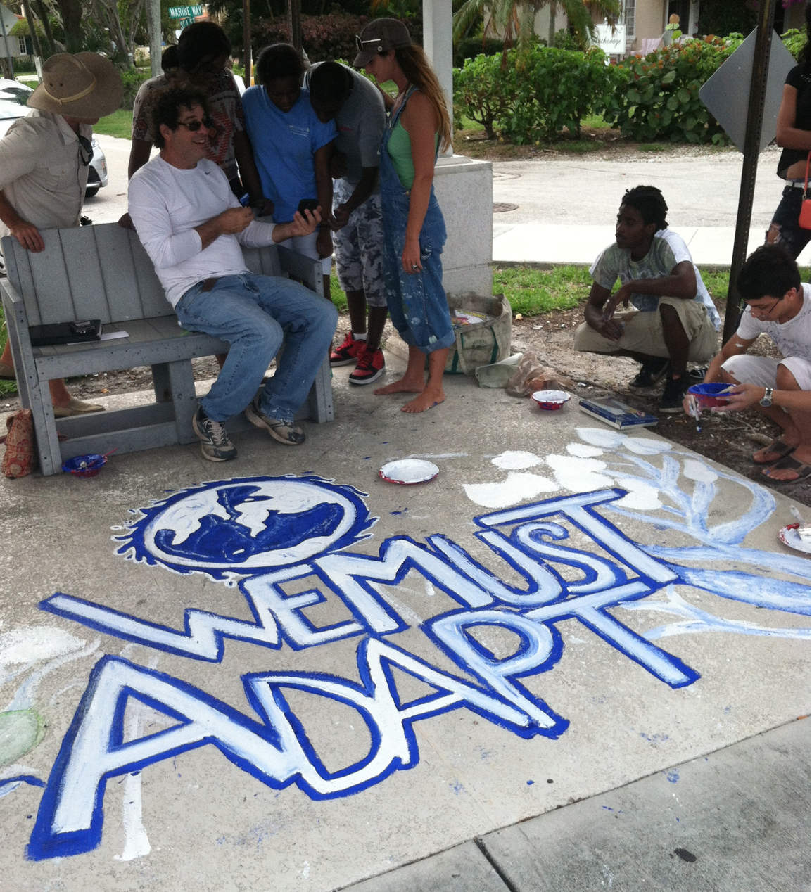
HighWaterLine Delray Beach
Notes:
These are storm drain murals created by students from an aftercare program for low income teens under the supervision of professional artist Jesse Etelson. The murals were designed by collaborating Delray Beach Artists. Here is a video about the Stormdrain mural project: https://vimeo.com/126071204/settings/privacy

Slide 50
National Water Dance
Notes:
The closing ceremony had a National Water Dance funded by the Delray Beach Public Art Advisory Board. Here is a link to a video:https://vimeo.com/126181856/settings/privacy

Slide 51
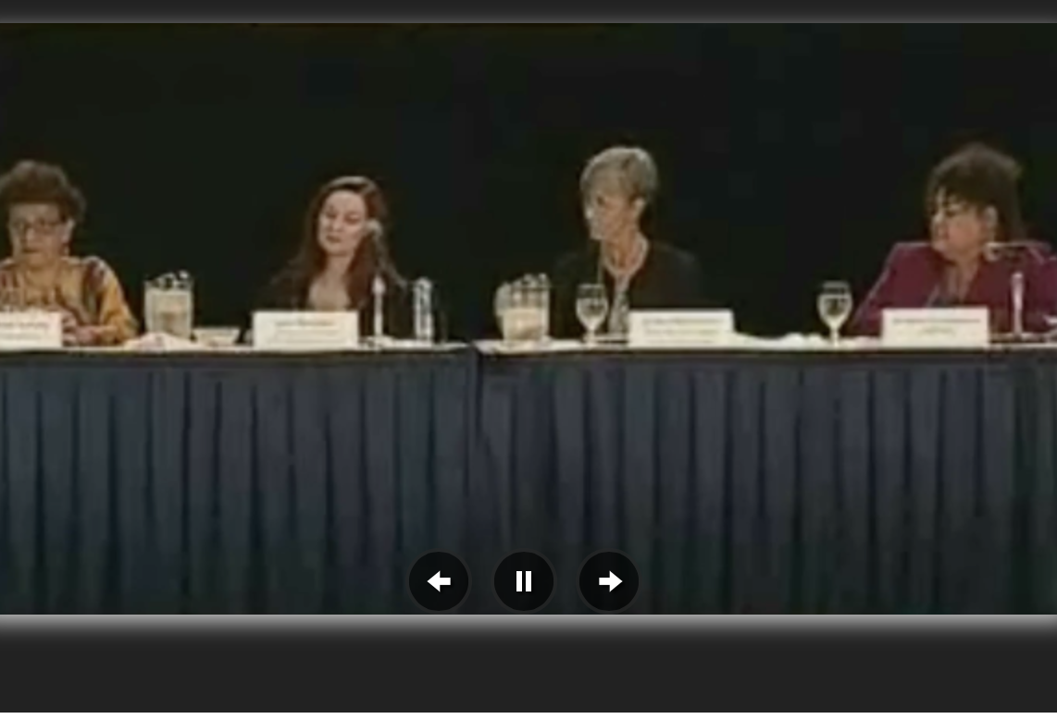
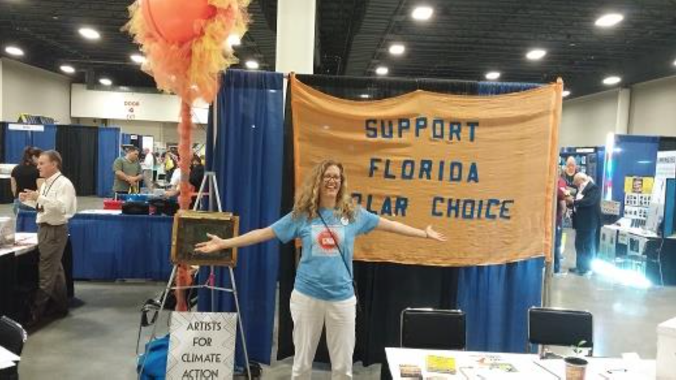
Other Events
Climate Leadership Summit Civic Engagement Panel Discussion 2014 in Ft. Lauderdale
People’s Climate March Miami October 2015
Letter of support to French Consulate in Miami Paris COP21 2016
Notes:
Here is a link to the Climate Leadership Summit Civic Engagement panel: http://broward.granicus.com/MediaPlayer.php?clip_id=1716

Slide 52
Notes:
Three organization within the coalition present an annual SLR Symposium. Most other members of the coalition staff tables during the event or facilitate breakout groups.

Slide 53
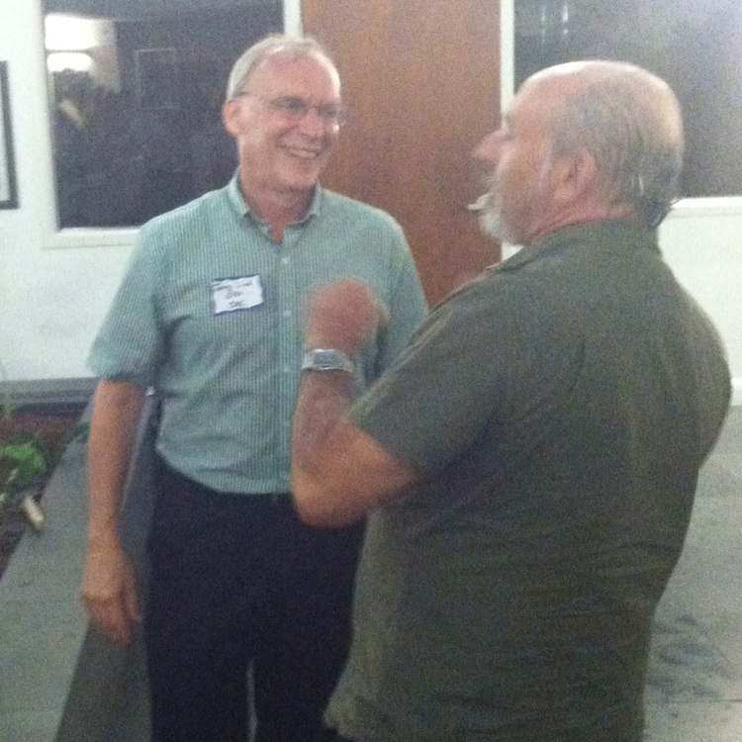
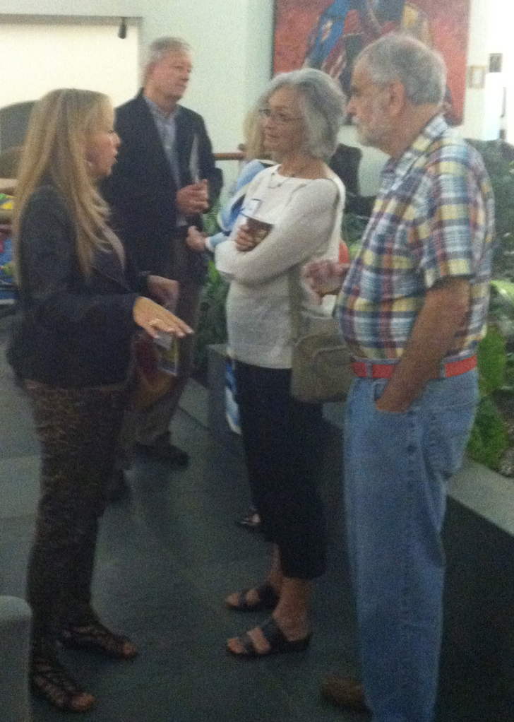
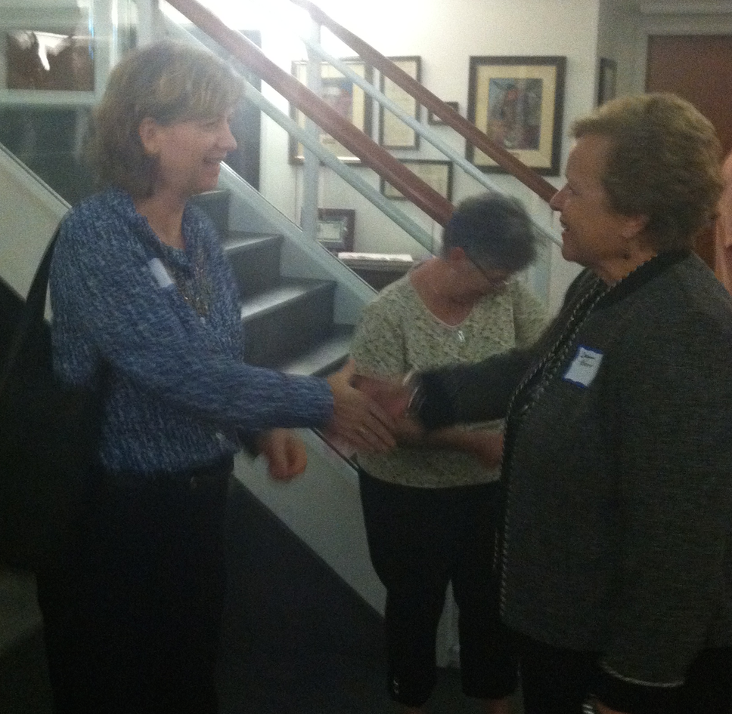
Host a Networking Event
Notes:
We hosted a networking event to expand our coalition. The law firm we had partnered with on Florida Earth Festival for tours of their LEED Gold building allowed us to use their offices.

Slide 54
Advocating at the State Level
Coalition Member Organizations Coordinate getting on the Legislative Delegation Agenda before our delegation heads to Tallahassee.
Notes:
The CAC of South Florida has coordinated its advocacy on the state level with other coalition organizations as well as with the legislative agenda of the Southeast Florida Climate Change Compact.

Slide 55
Coalition Coordination on Legislative Agenda
Share info on member organizations’ bills of concern
Provide testimonials and street level grassroots information on climate impacts to public officials in support of legislation
Coordination with the legislative agenda of the South Florida Climate Compact and newly formed Climate Committee with the League of Cities
Local Talking points up-managed into state and federal campaigns by member organizations
Notes:
Coordination with other entities in the region on advocacy at the State and Federal levels is important to amplify the message We try to support our member orgnaizations with grassroots data.

Slide 56
Support
Help Find People & Resources
Post Resources on QiQoChat: the Online Community for Florida iCAN
Share What has Worked and What Hasn’t
Notes:
Jan Booher will try to supply the following support for people trying to promote Actions and campaign like those presented in this Powerpoint.

Slide 57
What Can You Do?
UUs can Join UUJF to receive action alerts
Go to Tallahassee on Legislative Day Feb 8-9, 2016
Host a Candidates Forum
Visit Representatives When in Your District
Conduct Petition Drives in your Congregation and in the Community
SHARE EVERYTHING WITH EVERYONE AND SUPPORT THEIR EFFORTS!!!!
Notes:
The first item refers only to UUs. The second is time specific. All others apply to congregations of all faiths.

